Slide 1
CS 4350: Fundamentals of Software Engineering CS 5500: Foundations of Software Engineering Lesson 1.1 Course Introduction
Jon Bell, John Boyland, Mitch Wand
Khoury College of Computer Sciences

Slide 2
CS 4350: Fundamentals of Software Engineering CS 5500: Foundations of Software Engineering Lesson 1.1 Course Introduction
Jon Bell, John Boyland, Mitch Wand
Khoury College of Computer Sciences

Slide 3
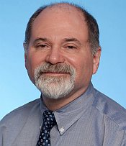


Instructors
Mitch Wand
Frank Tip
Jonathan Bell

Slide 4

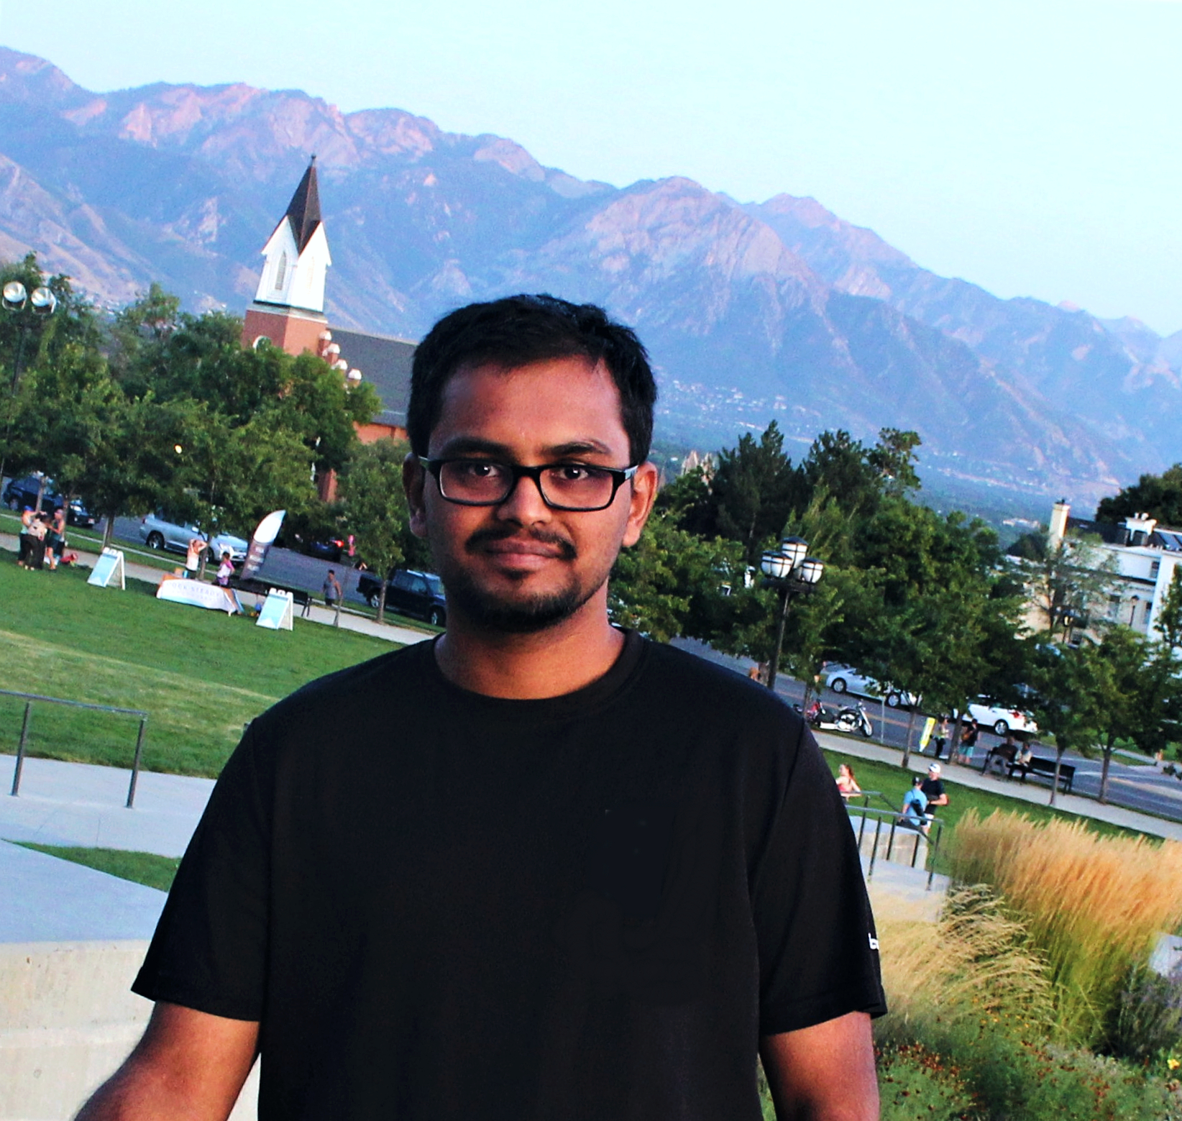

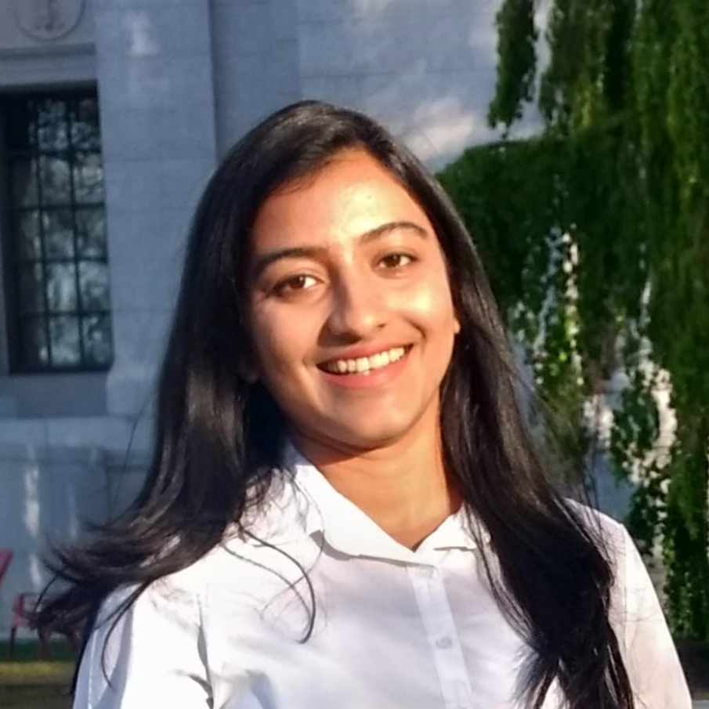
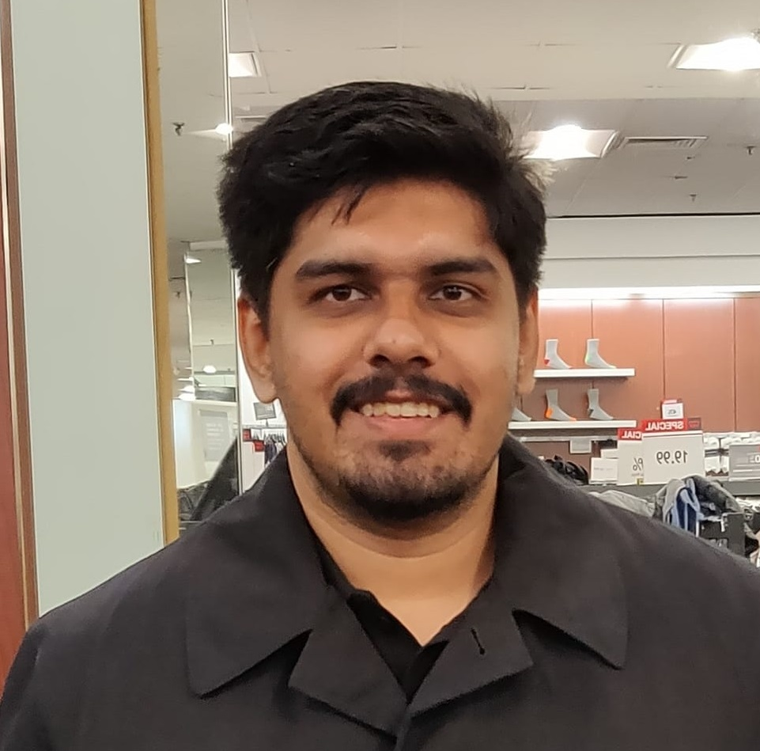

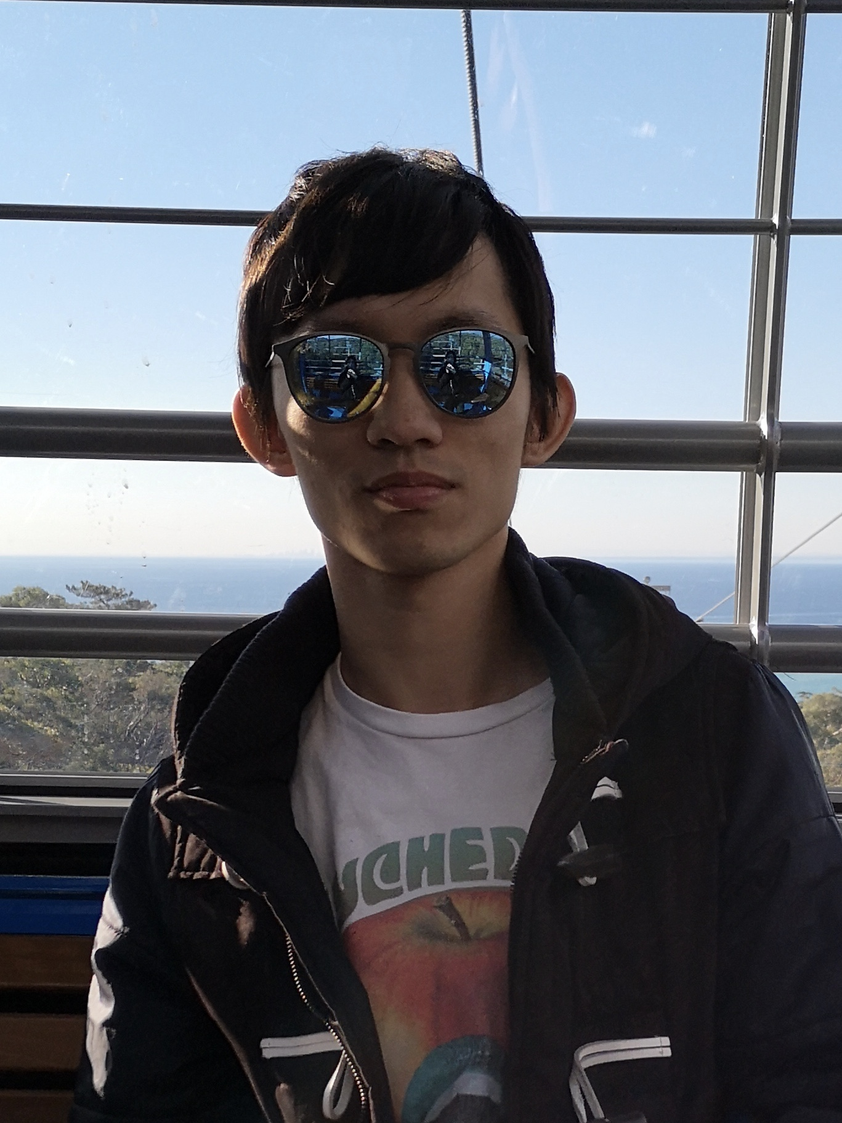
Teaching Assistants
Alexi Turcotte
Rajath Kashyap
Prajakta Rodrigues
Jake Feinbaum
Satyajit Gokhale
Magnus Frennberg
Weijie (Ben) Deng

Slide 5
Learning Objectives for this course:
By the end of this course you will--
Be able to define and describe the phases of the software engineering lifecycle.
Be able to explain the role of key processes and technologies in modern software development.
Be able to productively apply instances of major tools used in elementary SE tasks.
Design and implement a portfolio-worthy software engineering project in a small team environment that can be showcased to recruiters.
Notes:
other factors: careful design, extensible solutions, effective teamwork, etc.

Slide 6
Learning Objectives for this Lesson
By the end of this lesson you should be able to:
Explain what SE is and why it’s important
List your weekly obligations as a student
List the requirements for completing the course
Explain how assignments will be graded
To be finalized
Or maybe not... too much for now.

Slide 7
What is software engineering?
Good code is necessary but not sufficient
Software Engineering encompasses the tools and processes that we use to design, construct and maintain programs over time.

Slide 8
Good code is necessary but not sufficient
Developing software is a systems enterprise
there are many stakeholders
how to determine the requirements?
how to design code for:
reuse, readability, scale? other factors?
how to organize the development process?
how to make sure you've built the thing right?
how to make sure you've built the right thing?

Slide 9
SE includes Tools and Processes
The answers to those questions will depend on things like:
the size of the team
the size of the product
the longevity of the product
There's no one "right" way; there are always tradeoffs.
But there are best practices, which we will expect you to follow.

Slide 10
Approach
We will try to mirror the experience of a young software engineer joining a new team...
"onboarding" to a new codebase
start with small individual projects (apx. 4 homeworks)
participate in small team project to design & develop a major new feature (Team Project, with intermediate deliverables)

Slide 11
Technology
Too specific for now?
In our shop we use:
TypeScript as implementation language
React for web pages
Chakra-UI for design elements
Visual Studio Code
+ git, etc...

Slide 12
Course Mechanics
Our goal is to provide a productive learning environment to both remote and on-the-ground students
“Flipped-Classroom” Model:
Lecture videos will be posted at start of week: watch videos before coming to class
During scheduled class time: discussion, activities. If you come in person, bring laptop and headphones
You are expected to come to class, either in person or remote.

Slide 13
Laboratories (Tutorials)
There will be regular laboratory exercises to give you practice with the technologies we will use.
Not graded, but highly recommended
Typically, will consist of structured steps that will guide you through a typical task
Typically asynchronous, but the TAs will have a dedicated office hour for handling your questions about the lab exercise.

Slide 14
Pedagogy
We are big on "learning objectives"
A learning objective is something you should be able to do after completing the learning experience (lesson|homework|etc.).
Every lesson and every homework will have explicit learning goals.
We will tell you these before and remind you of them afterwards
like Slides 5-6!

Slide 15
Course Requirements
four?
There will be three programming assignments and a final project. You will complete the assignments individually, and the project in a group of 3 or 4. The overall grading breakdown is:
36% Programming Assignments
29% Final Project
10% Quizes and in-class activities
25% Final Exam
to be refined

Slide 16
Grade Appeal Policy
If you have concerns regarding the grading of your work, please let us know right away by opening a regrade request in GradeScope.
Do not post on Piazza or email your TA or instructor
GradeScope provides an interface that allows us to review all regrade requests in one place.
All regrade requests must be submitted within 7 days from your receipt of the graded work.
If your regrade request is closed and you feel that the response was not satisfactory, you may appeal to the instructor via email within 48 hours

Slide 17
Late Policy
Your work is late if it is not turned in by the deadline.
10% will be deducted for late HW assignments will turned in within 24 hours after the due date
HW assignments submitted more than 24 hours late will receive a zero.
If you're worried about being busy around the time of a HW submission, please plan ahead and get started early.

Slide 18
Academic Integrity (1)
Students must work individually on all homework assignments.
We encourage you to have high-level discussions with other students in the class about the assignments, however, we require that when you turn in an assignment, it is only your work. That is, copying any part of another student's assignment is strictly prohibited.
If you steal someone else's work, you fail the class.
You are responsible for protecting your work. If someone uses your work, with or without your permission, you fail the class.
I think we need to have a longer discussion about what this means.

Slide 19
Academic Integrity (2)
You are free to reuse small snippets of example code found on the Internet (e.g. via StackOverflow) provided that it is attributed.
If you are concerned that by reusing and attributing that copied code it may appear that you didn't complete the assignment yourself, then please raise a discussion with the instructor.
If you are in doubt whether using others' work is allowed, you should assume that it is NOT allowed unless the instructors confirm otherwise.

Slide 20
Review
Now that you've studied this lesson, you should be able to:
Explain what SE is and why it’s important
List your weekly obligations as a student
List the requirements for completing the course
We told you that we were going to list the learning objectives at the beginning and the end of each lesson!

Slide 21
OK, now let’s get down to work!
In our next lesson, we'll learn about the basic principles of well-designed software

